Slide 1

What variables determine if a US citizen earns more or less than USD $50K?
Maine Isasi
Margarida Pereira
Pablo Gallegos
Sanjo Joy
Isaac Chaljub

Slide 2

Key findings
Controllable variables such as years of education, profits and losses in stock markets, and hours of work per week, while non-controllable variable age were all highly relevant to place citizens above the $50K threshold.
Another important variable was occupation, as white-collar jobs (as expected) give people a higher chance of obtaining a higher income.
The model built had a good performance, giving the government the ability to use and tweak it for further studies.

Slide 3

Approach to results
The dataset was inspected, and null or non-consistent values were handled. Irrelevant or redundant features were dropped to ensure the model only considered important information.
A pipeline consisting of four models was developed, using Decision Tree, Bagging, Random Forest, and Boosting Classifier.
Accuracy was chosen as the main evaluation metric, with precision used as secondary metric to assess overall performance.

Slide 4
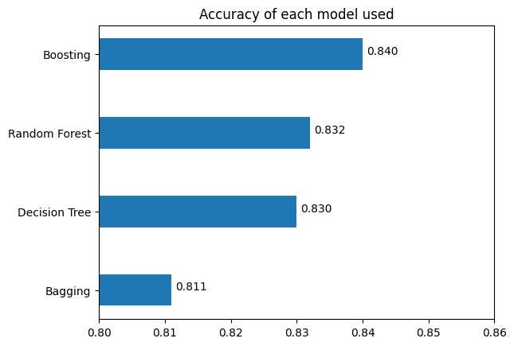
Model comparison
We look at the accuracy of the models as first metric, where we can see that Boosting is the winner over the rest of them
Precision also tells us that Boosting is the best performer out of the four used, indicating a strong performance
When comparing time, Decision Tree emerges as the clear winner, using less than 75% of the time used by both Random Forest and Boosting Classifier

Slide 5
Conclusions and recommendations
Policymakers and social programs should focus on investing in scholarships and grants for the population, as education is a direct predictor of higher income.
Financial Education also plays an important part in wealth generation, signaling that efforts focused on financial literacy can also benefit the citizens.
Opening Training Programs within companies and social certification programs with support from the government can also positively impact income, generating a holistic approach from multiple fronts.
Lastly, for further studies the team recommends using the Boosting model when higher precision is paramount and going for the Decision Tree model if process time is of essence.

